Slide 1
Cornerstone City Church Peninsula Plus Community Hoo Are Ya
26th November 2023

Slide 2


Slide 3


Slide 4


Slide 5
Everlasting God
CCLI Song # 4556538
Brenton Brown | Ken Riley
© 2005 Thankyou Music (Admin. by Integrity Music Ltd)
For use solely with the SongSelect® Terms of Use. All rights reserved. www.ccli.com
CCLI Licence No. 33265

Slide 6
1/3
Strength will rise as we wait upon the Lord
We will wait upon the Lord
We will wait upon the Lord
Strength will rise as we wait upon the Lord
We will wait upon the Lord
We will wait upon the Lord

Slide 7
2/3
Our God You reign forever
Our Hope our strong Deliv'rer

Slide 8
3/3
You are the everlasting God
The everlasting God
You do not faint
You won't grow weary
You're the defender of the weak
You comfort those in need
You lift us up on wings like eagles

Slide 9
House Of The Lord
CCLI Song # 7168995
© 2020 Phil Wickham MusicSimply Global SongsBe Essential SongsCashagamble Jet Music
For use solely with the SongSelect® Terms of Use. All rights reserved. www.ccli.com
Note: Reproduction of this sheet music requires a CCLI Music Reproduction Licence. Please report all copies.
CCLI Licence No. 33265

Slide 10
1/5
We worship the God who was
We worship the God who is
We worship the God who evermore will be
He opened the prison doors
He parted the raging sea
My God He holds the victory yeah

Slide 11
2/5
There’s joy in the house of the Lord
There’s joy in the house of the Lord today
And we won’t be quiet
We shout out Your praise

Slide 12
3/5
There’s joy in the house of the Lord
Our God is surely in this place
And we won’t be quiet
We shout out Your praise

Slide 13
4/5
We sing to the God who heals
We sing to the God who saves
We sing to the God who always makes a way
'Cause He hung up on that cross
Then He rose up from that grave
My God’s still rolling stones away

Slide 14
5/5
We were the beggars
Now we’re royalty
We were the prisoners
Now we’re running free
We are forgiven accepted
Redeemed by His grace
Let the house of the Lord sing praise

Slide 16
My Worship
CCLI Song # 7098688
Philip Nathan Thompson | Zenzo Matoga
© 2017 Integrity Worship Music (Admin. by Integrity Music Ltd)
Phil Thompson Worship (Admin. by Integrity Music Ltd)
Zenzo Matoga Music (Admin. by Integrity Music Ltd)
For use solely with the SongSelect® Terms of Use. All rights reserved. www.ccli.com
CCLI Licence No. 33265

Slide 17
1/3
You Lord
You are worthy
And no one can worship You for me
For all of the things You've done for me
And no one can worship You for me

Slide 18
2/3
Here's my worship
All of my worship
Receive my worship
All of my worship
(REPEAT)

Slide 19
3/3
And I will not be silent
I will always worship You
As long as I am breathing
I will always worship You

Slide 21
Great Are You Lord
CCLI Song # 6460220
David Leonard | Jason Ingram | Leslie Jordan
© 2012 Open Hands Music (Admin. by Essential Music Publishing LLC)
So Essential Tunes (Admin. by Essential Music Publishing LLC)
Integrity's Praise! Music (Admin. by Integrity Music Ltd)
Little Way Creative (Admin. by Integrity Music Ltd)
For use solely with the SongSelect® Terms of Use. All rights reserved. www.ccli.com
CCLI Licence No. 33265

Slide 22
1/3
You give life You are love
You bring light to the darkness
You give hope You restore ev'ry heart that is broken
And great are You Lord

Slide 23
2/3
It's Your breath in our lungs
So we pour out our praise
We pour out our praise
It's Your breath in our lungs
So we pour out our praise to You only

Slide 24
3/3
And all the earth will shout Your praise
Our hearts will cry these bones will sing
Great are You Lord
(REPEAT)

Slide 25


Slide 26
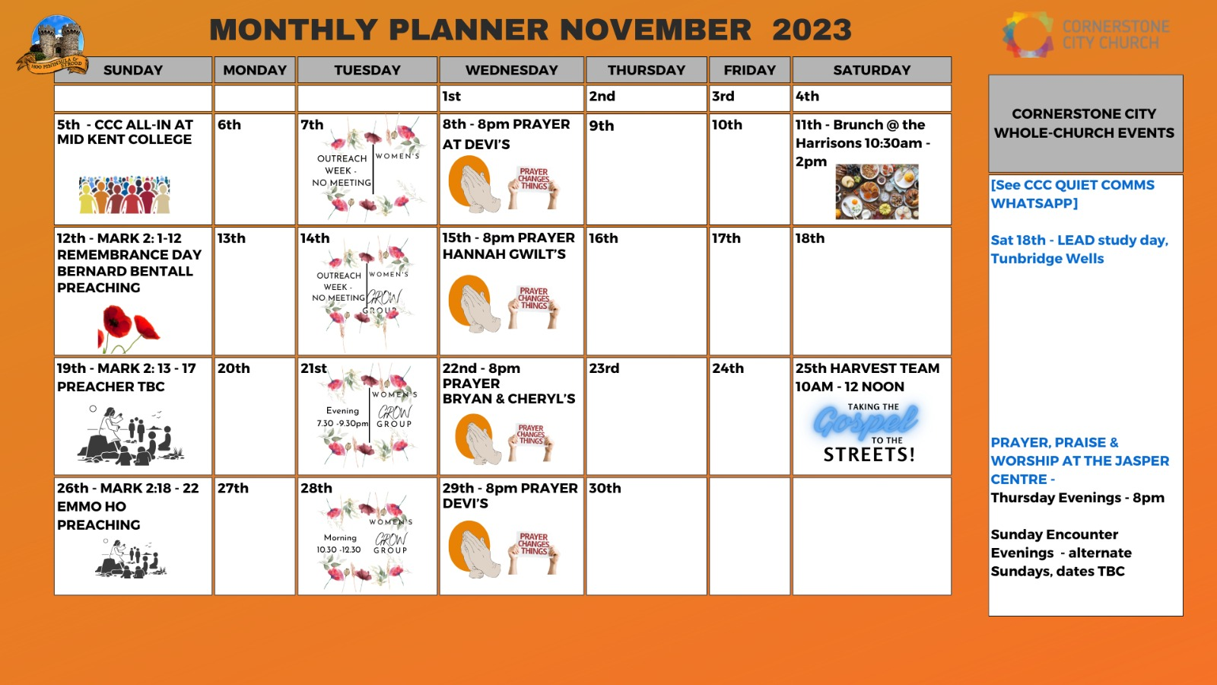

Slide 27


Slide 28
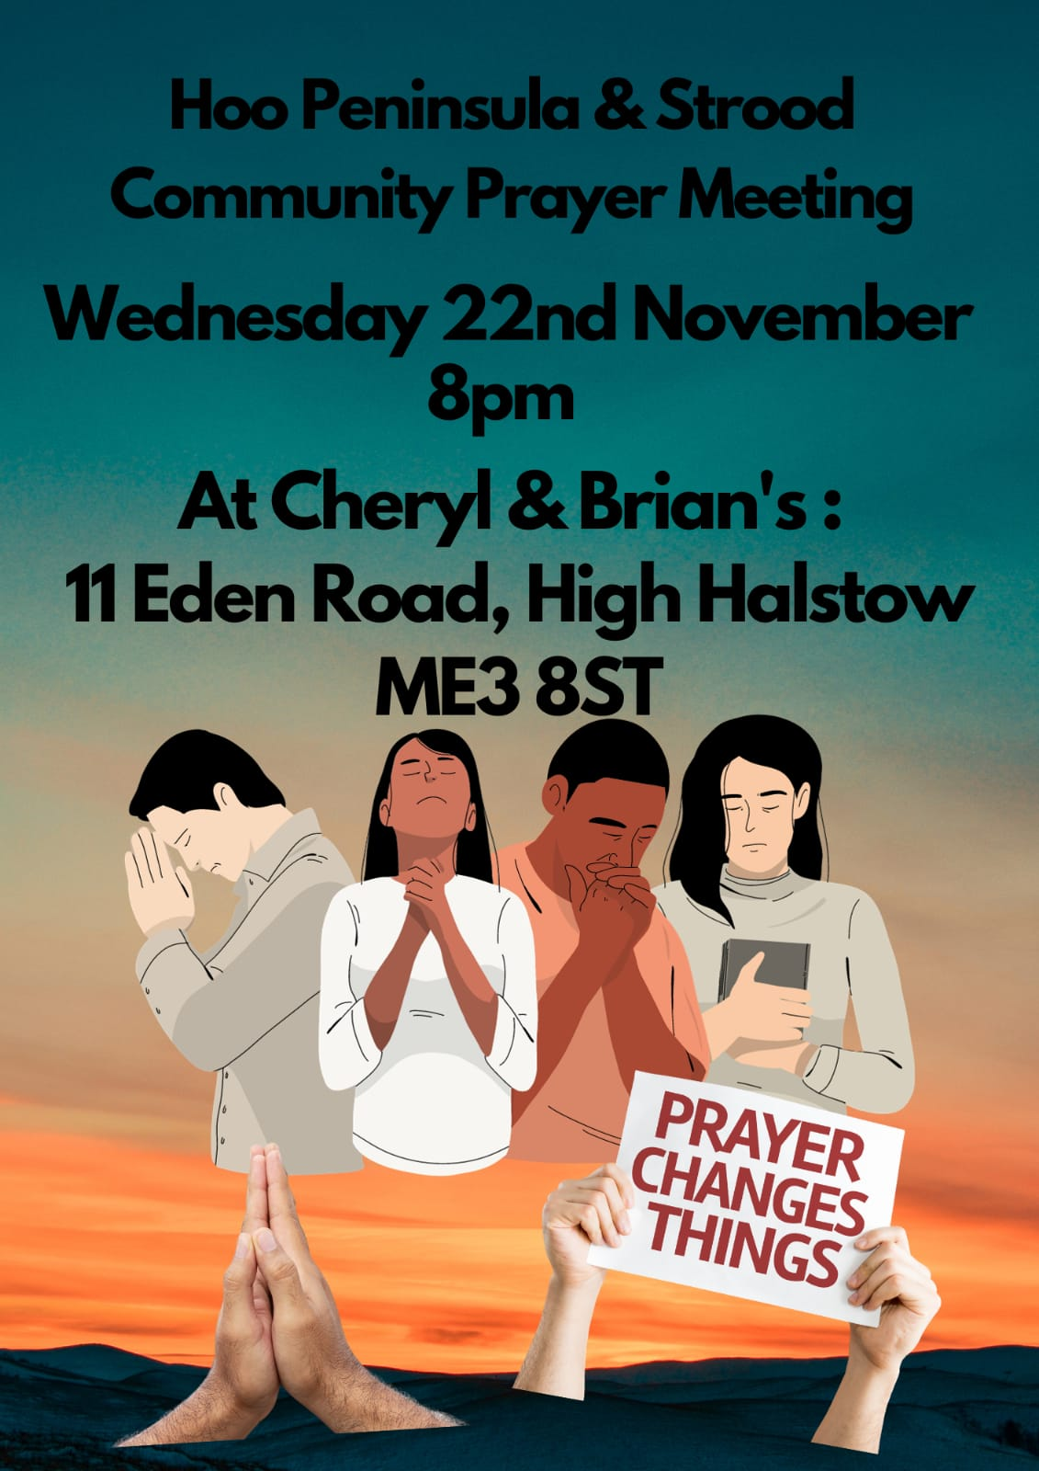

Slide 29


Slide 30
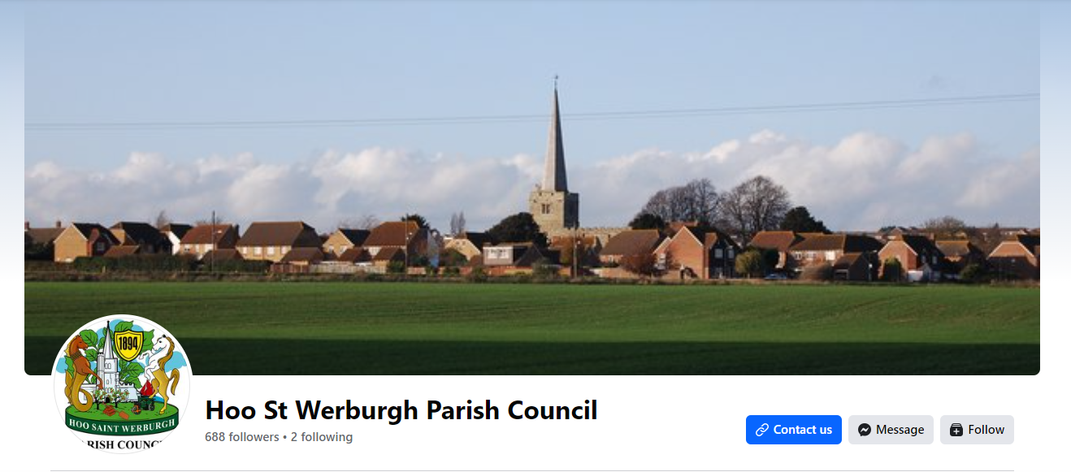
Christmas Celebrationson 8th December in Hoo Square at 6pm
Practice on Monday 4th December at Dele & Florence house. Contact Dele/Florence if you are interested and want to sing in our choir

Slide 31


Slide 32
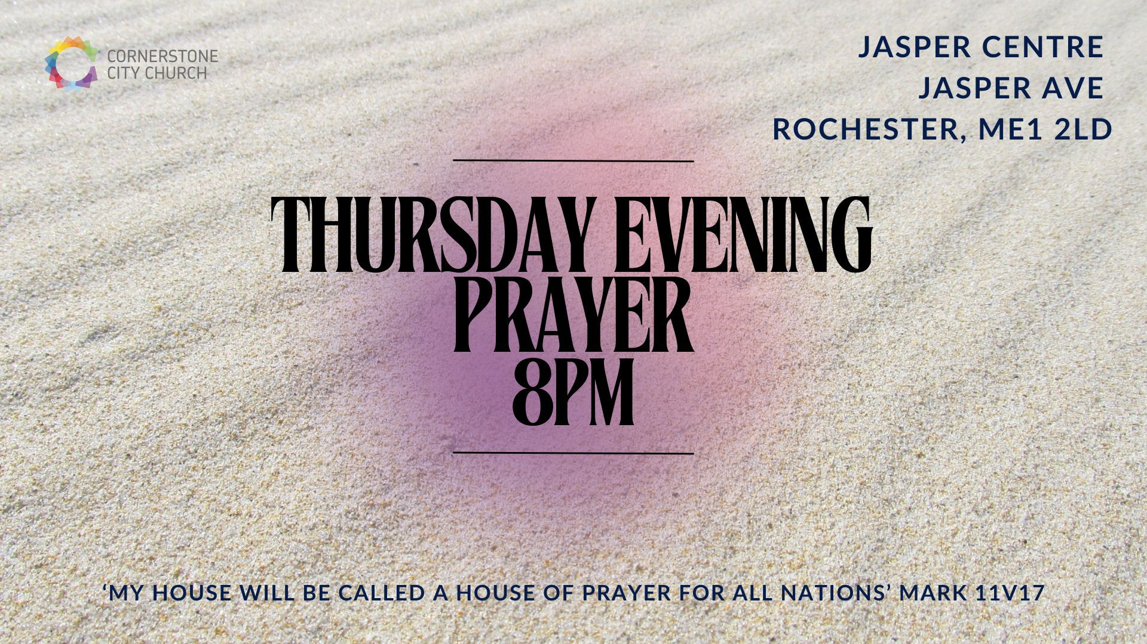

Slide 33


Slide 34


Slide 35


Slide 36


Slide 37
2 Corinthians 14 May the grace of the Lord Jesus Christ, and the love of God, and the fellowship of the Holy Spirit be with you all

